Slide 1
Python Programming Project Group 3: Dice Rolling Simulator
Group Leader : Denis Mun
Group Member : Engyong Tay
Aiping Tan
Huiyee Sim
Rene Boy

Slide 2
Agenda
1
Background
5
Program Screenshot
2
Timeline & Member’s role
6
File Output
3
Flowchart
4
Guideline to start program

Slide 3
1. Background of idea
Implement a program to simulate 2 dices rolling, with output of total numbers of rolling and how many time the dice matched.
The values on the pairs of die and rolling date & time ﻿﻿should be output into a file.

Slide 4
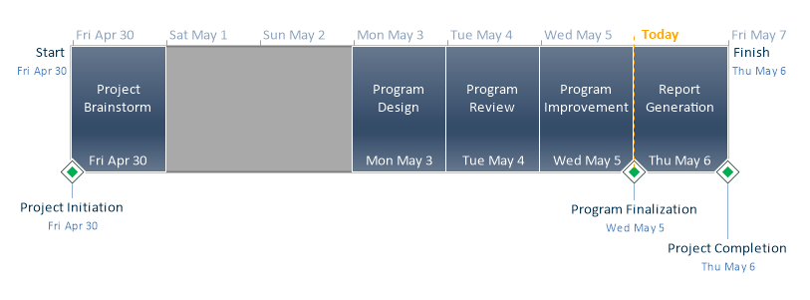
2. Timeline & Member’s Role
All team members (Denis, EY, Aiping, Rene and Sim) involved in discussion.

Slide 5
3. Flowchart
Construct GUI
(window, label, button)
Roll Button Click?
No
Yes
Random dice 1 & 2
Record result
Display Image for dice 1 & 2
Increase number of total roll
Dice 1 = Dice 2
?
No
Yes
Increase number of total match

Slide 6
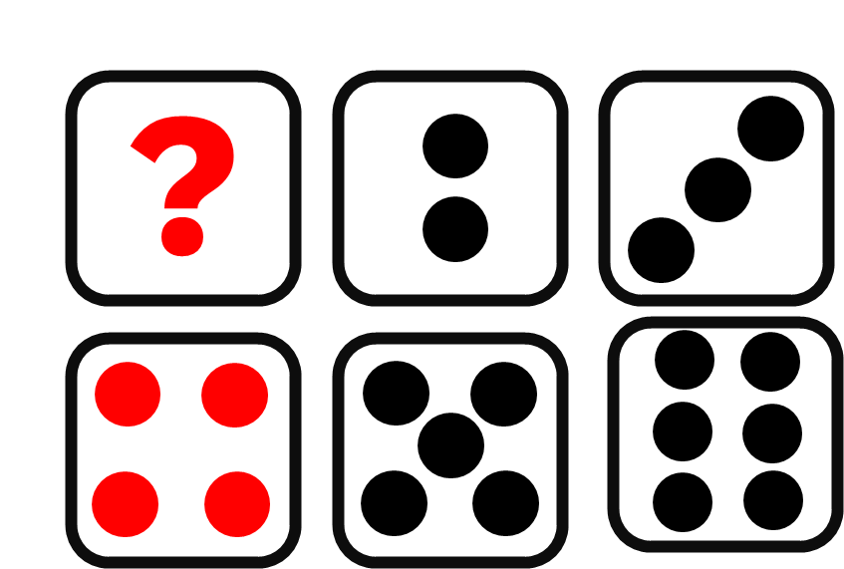
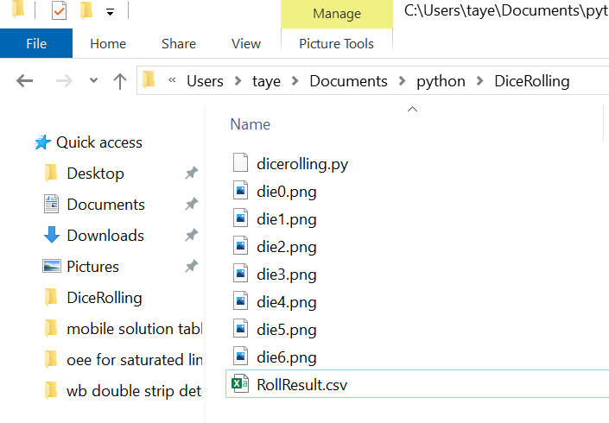
4. Guideline to start program
To activate learn-python environment
conda activate learn-python
To install tkinter
conda install –c anaconda tk
To install pillow
conda install –c anaconda pillow
To prepare dice picture (using powerpoint)
To copy program and pictures to folder DiceRolling
To execute script
python dicerolling.py

Slide 7
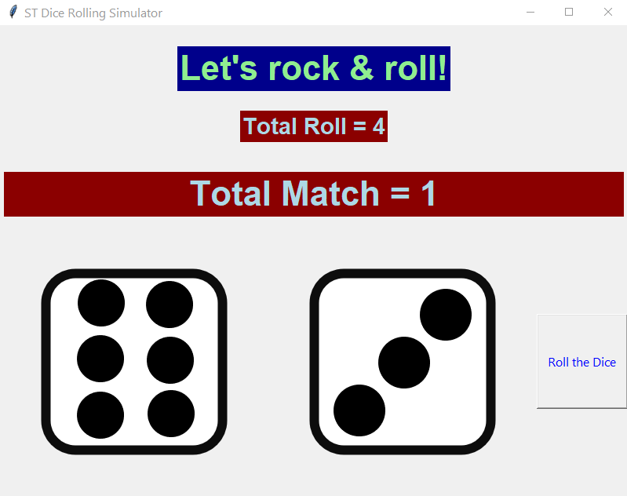
5. Program Screenshot

Slide 8
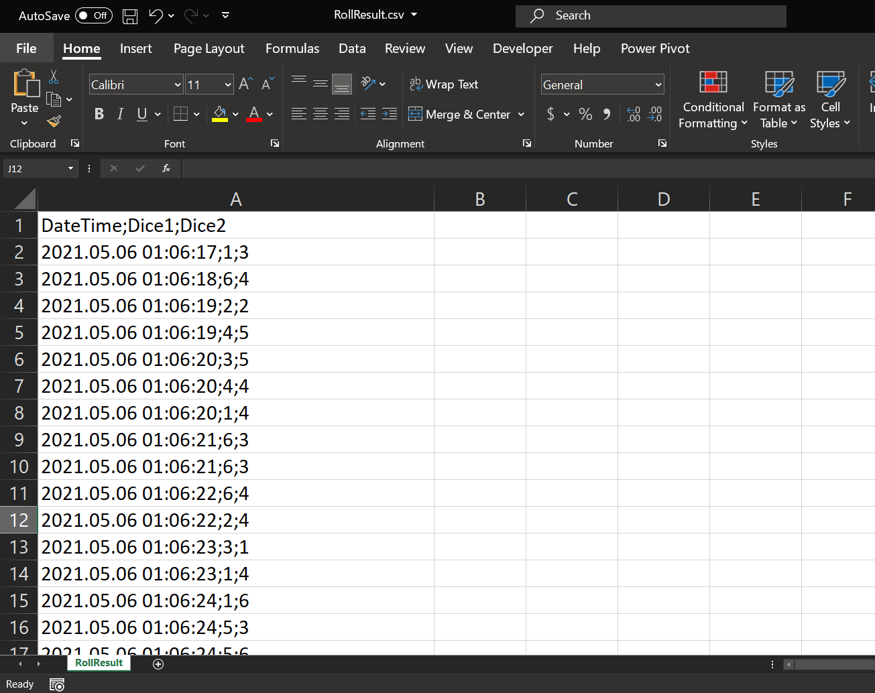
6. File Output

